Slide 1

Project Title: Image Transformation Using Python & Numpy
COMPUTER SCIENCE & MATHEMATICS

Slide 2
Name: Atharva S Gadad
Name: Adarsh Kumar
Team Members
SRN : PES1UC20CS088
SRN: PES2UC20CS016
Name:
Ayush Kumar Gupta
Name:
Chetan Reddy
SRN : PES1UC20CS095
SRN: : PES1UC20CS109

Slide 3
Project Objective Image manipulation using numpy arrays to show the use of Linear Algebra in these techniques

Slide 4
TABLE OF CONTENTS
Grayscale
01
Upscale
03
Edges Detection
02
Convert image to grayscale
Perform edge detection on given image
Upscale image

Slide 5
TABLE OF CONTENTS
Downscale
04
Rotate
06
Flip
05
Downscale Image
Flips the image
Rotate image by given angle

Slide 6
TABLE OF CONTENTS
Invert Colour
07
Transparency
09
Contrast
08
Invert colors of the image
Increasing the contrast of the Image
Makes Images transparent

Slide 7
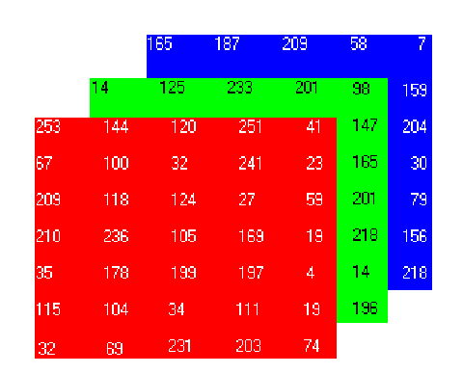
SOME BASICS

Slide 8
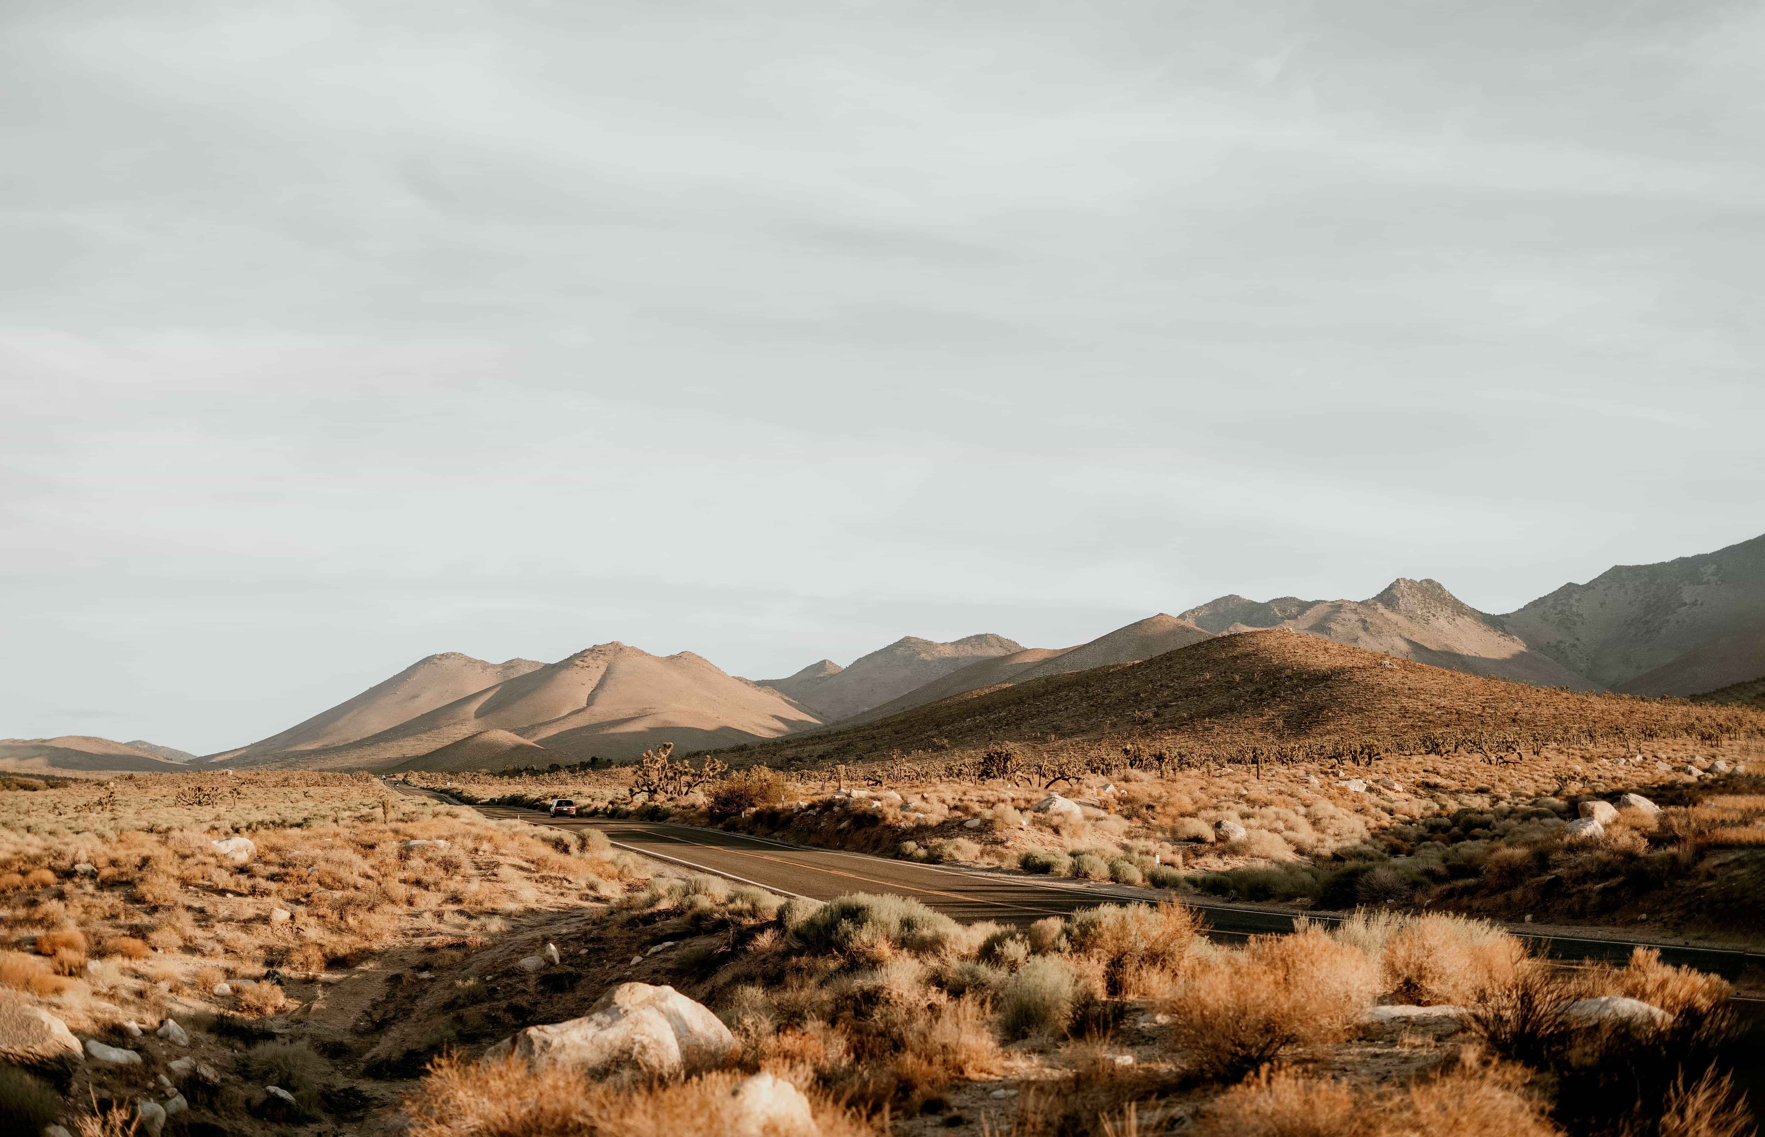
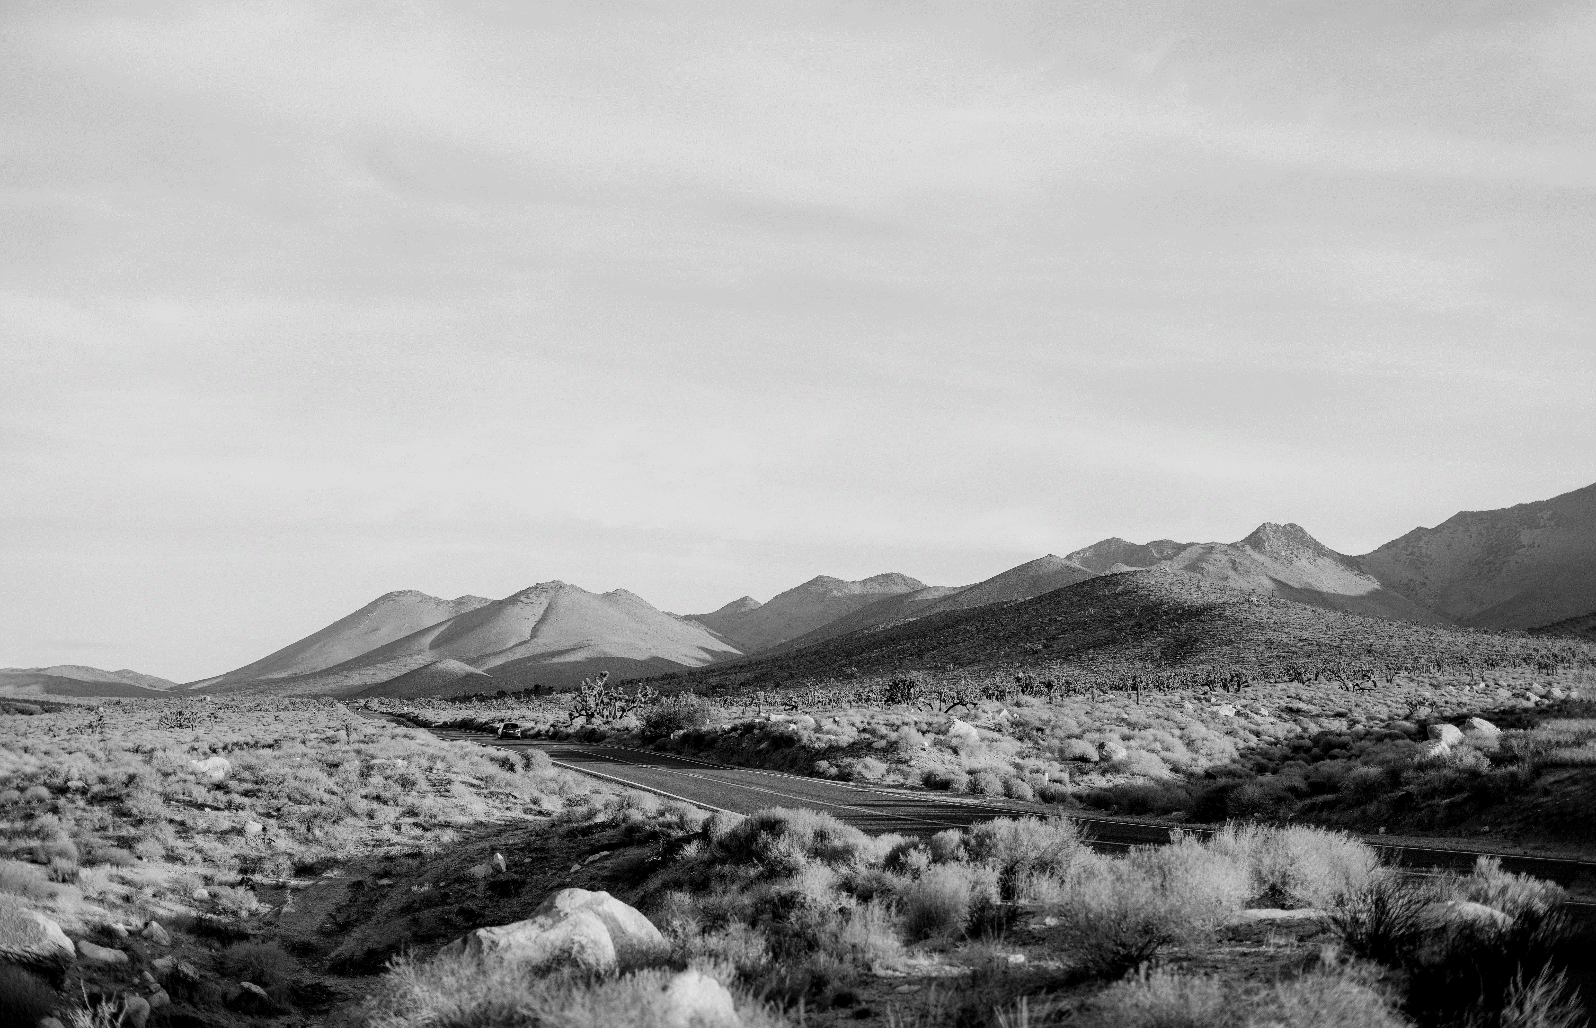
Original Img
Grayscale
After Operation

Slide 9
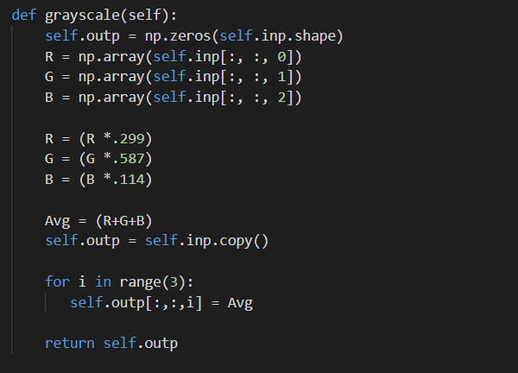
CODE

Slide 10
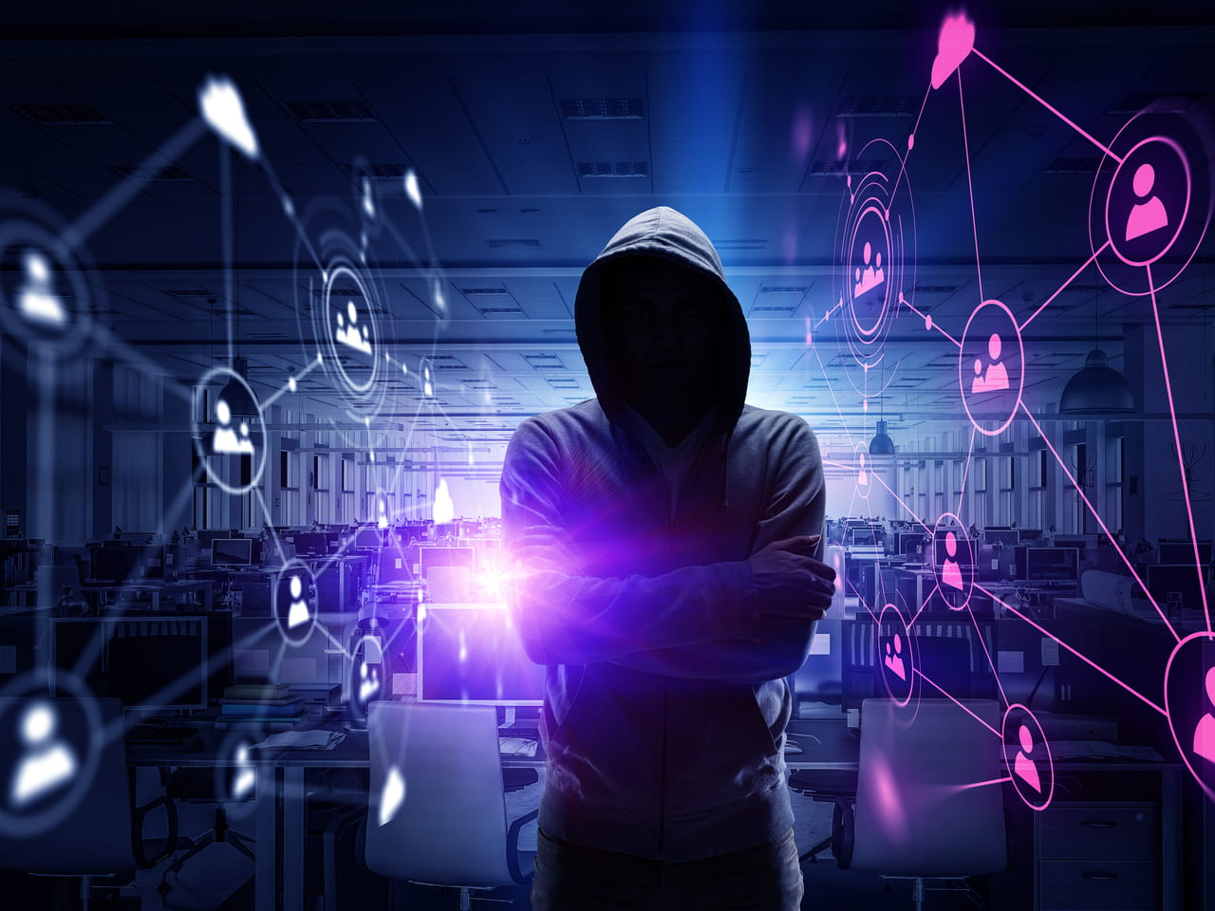
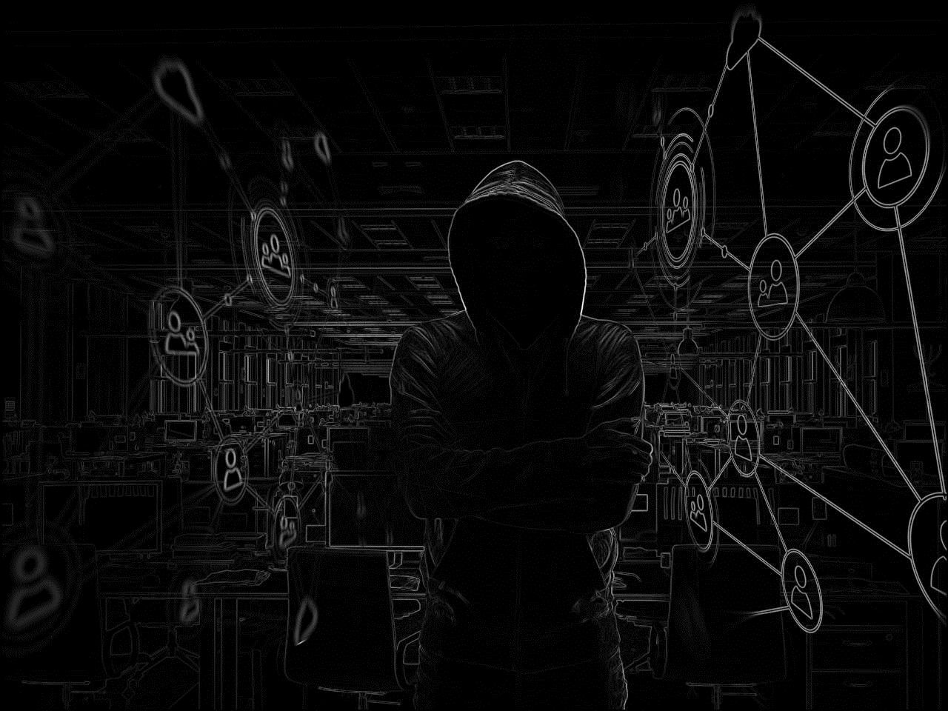
Original Img
Edges Detection
After Operation

Slide 11
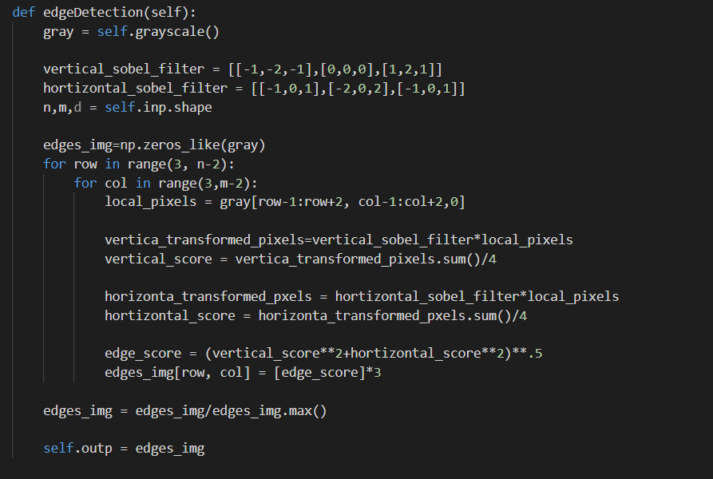
CODE

Slide 12


Original Img
Upscale
After Operation

Slide 13
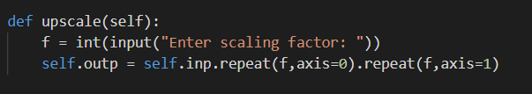
CODE

Slide 14
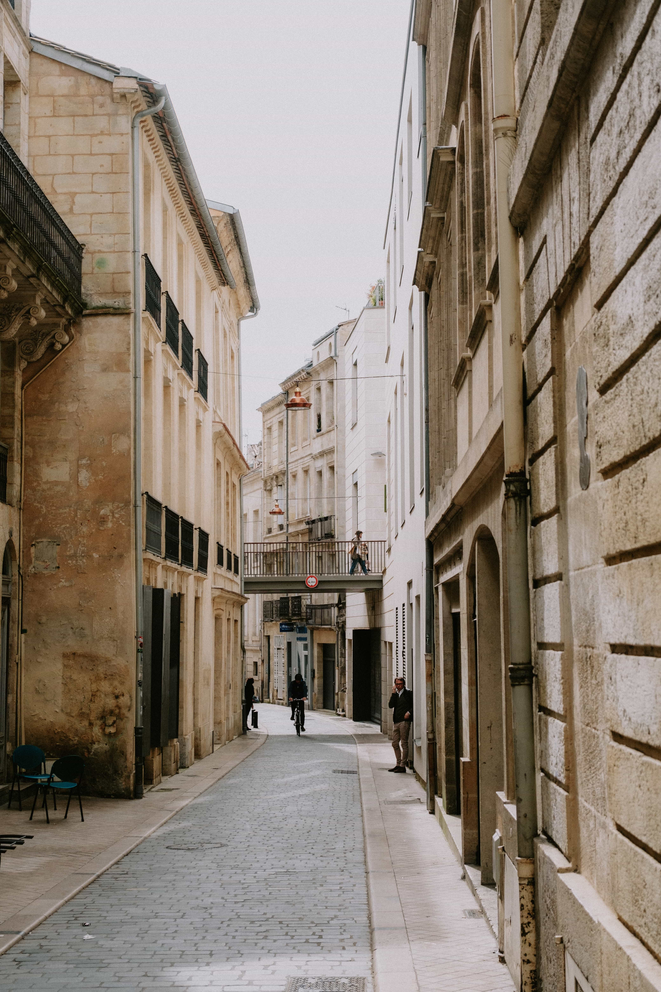
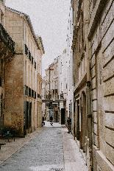
Original Img
Downscale
After Operation

Slide 15
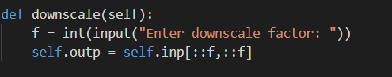
CODE

Slide 16
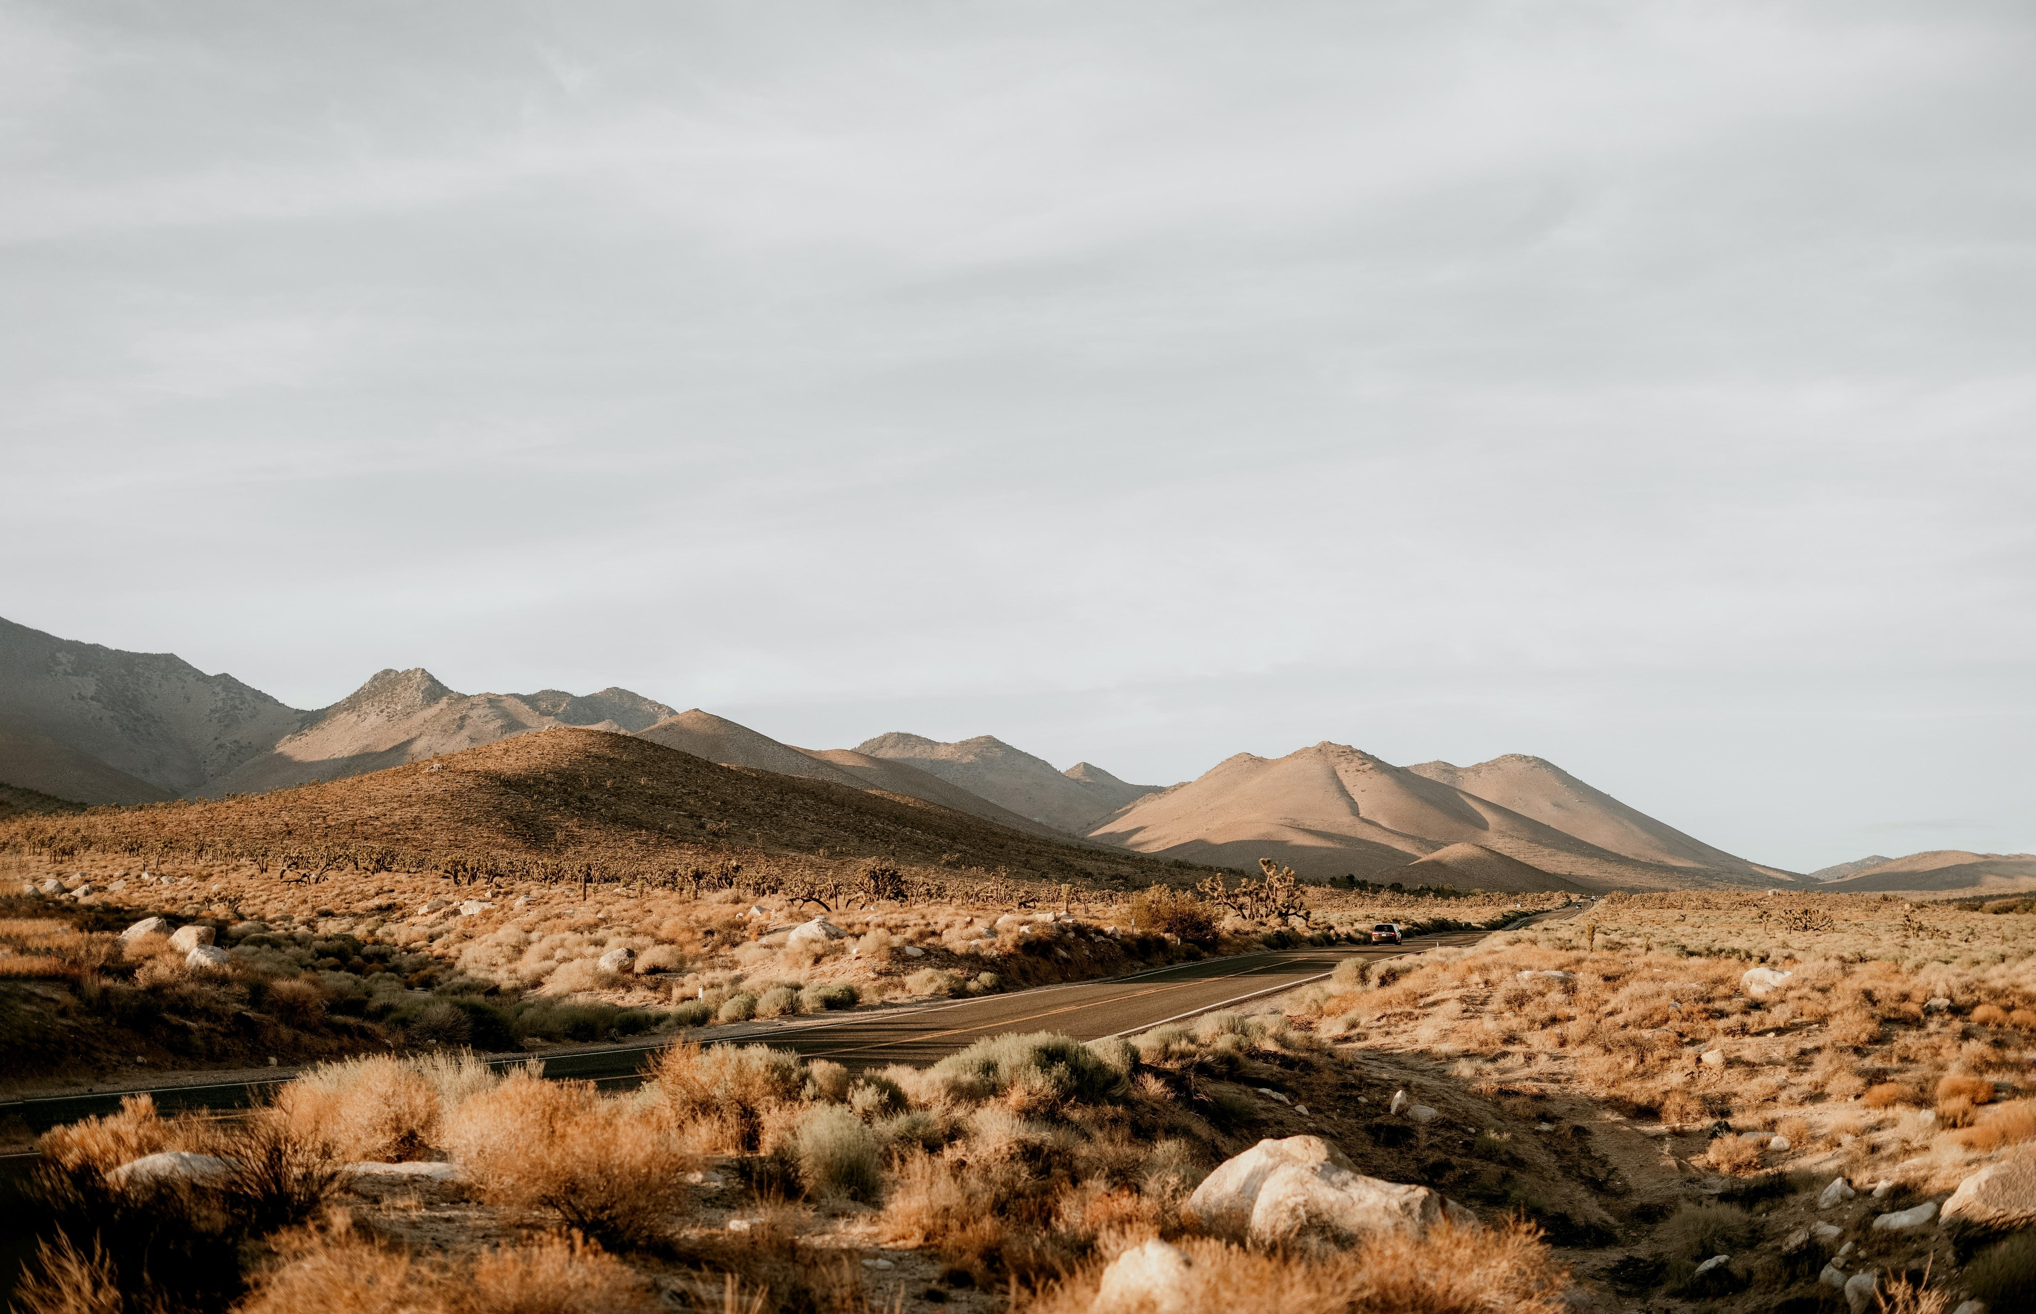
Original Img
Flip
After Operation

Slide 17
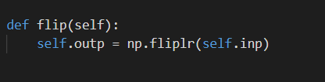
CODE

Slide 18
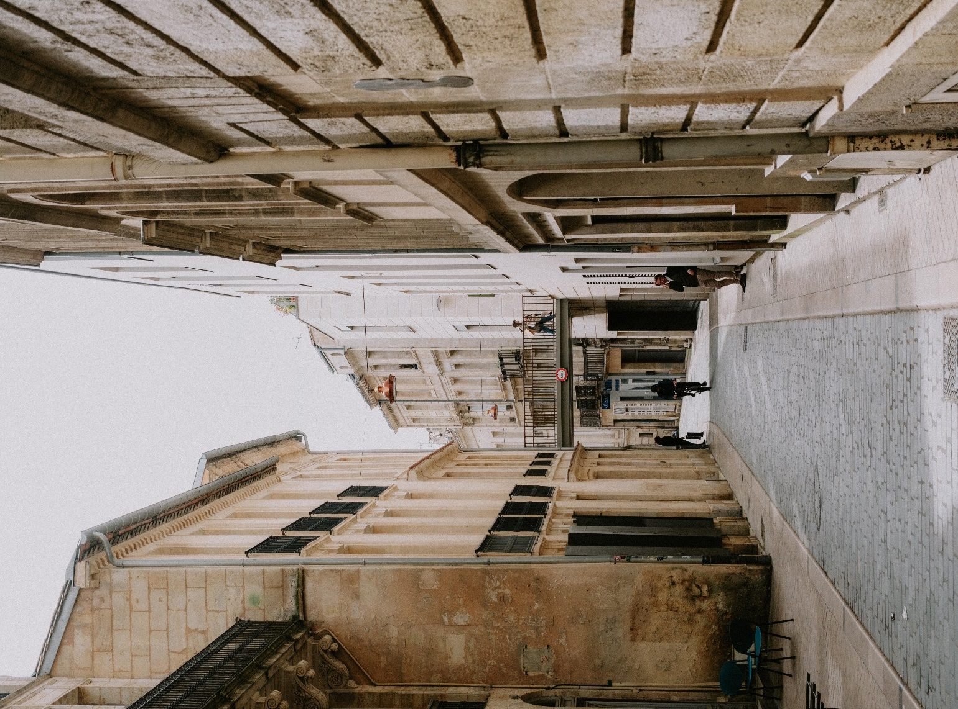
Original Img
Rotate
After Operation

Slide 19
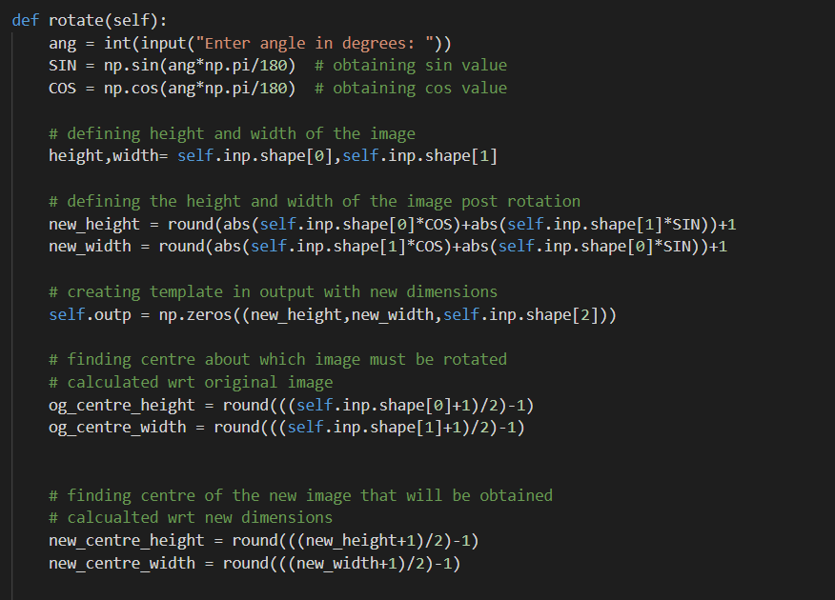
CODE

Slide 20
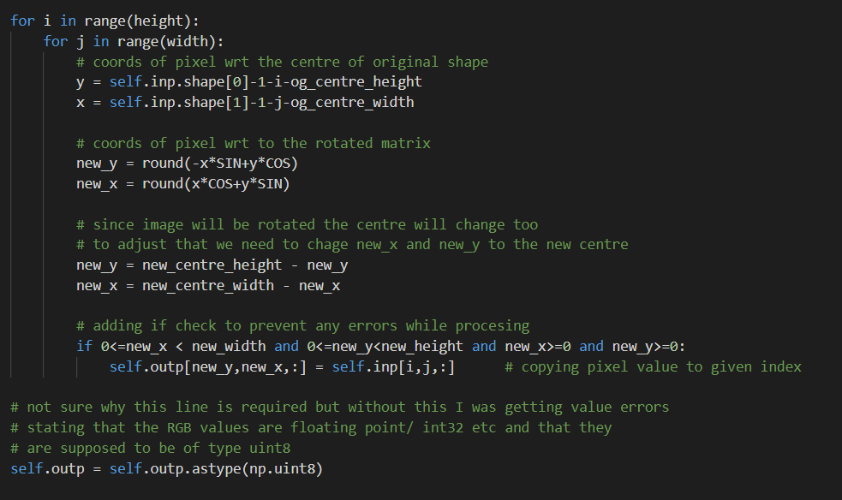
CODE

Slide 21
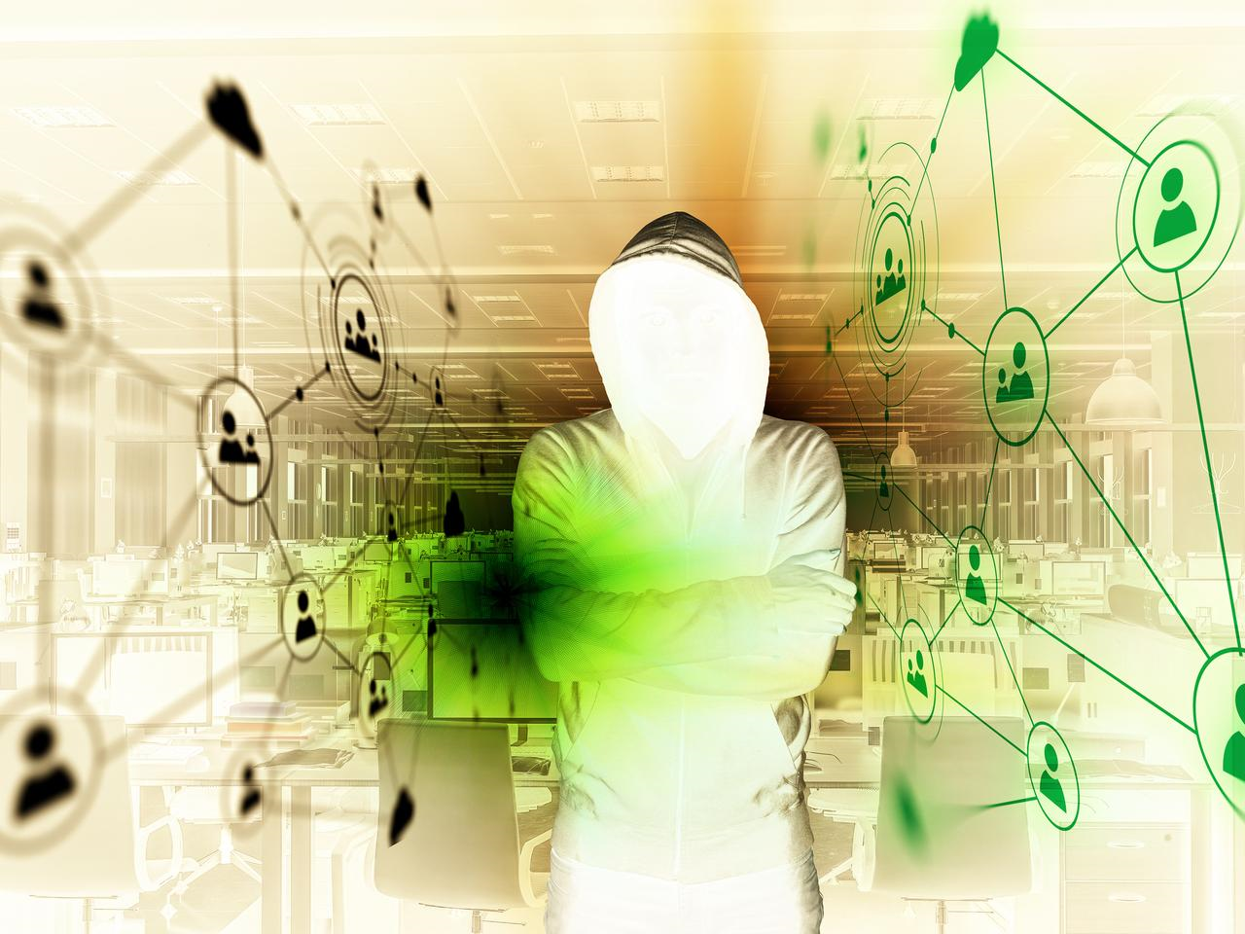
Original Img
Invert Colour
After Operation

Slide 22
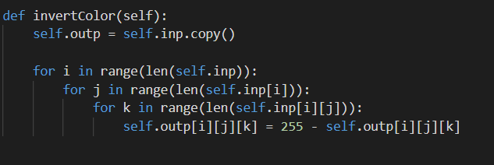
CODE

Slide 23
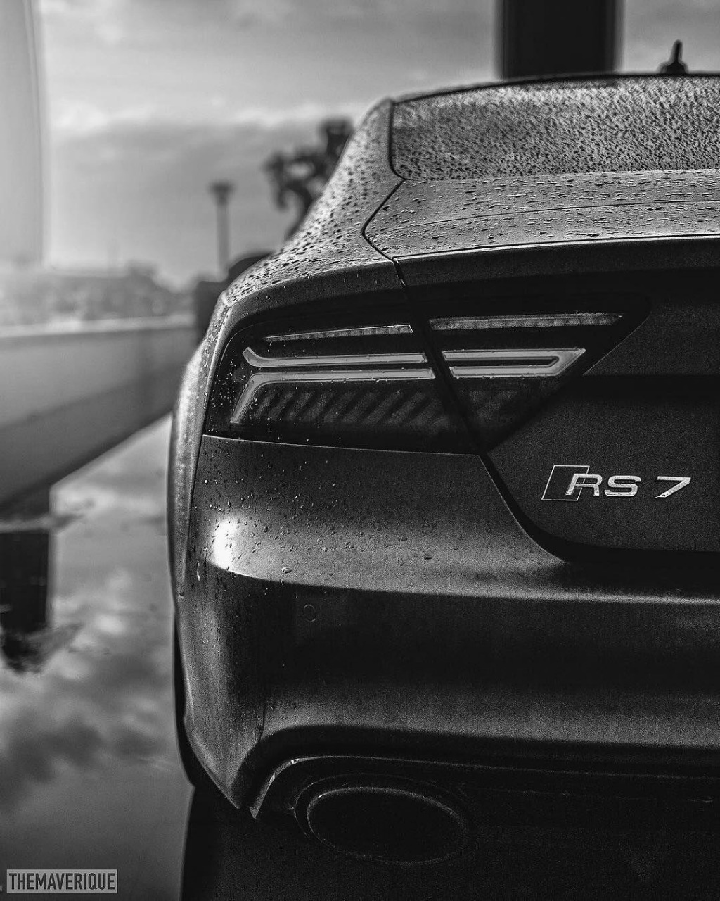

Original Img
Contrast
After Operation

Slide 24
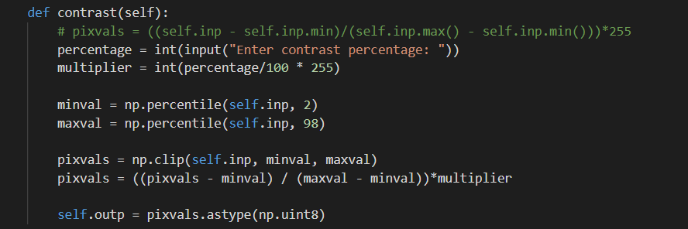
CODE

Slide 25
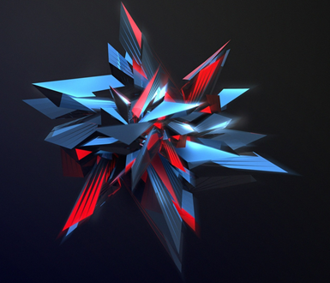
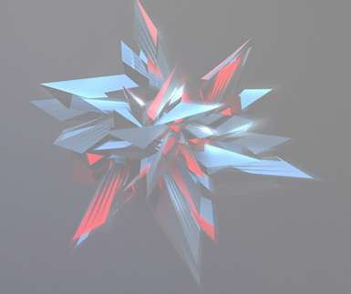
Original Img
Transparency
After Operation

Slide 26
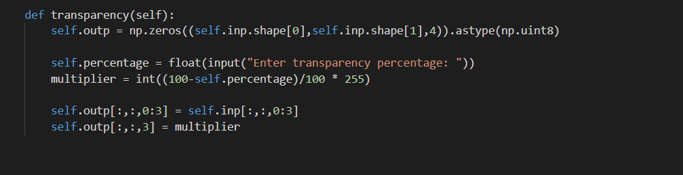
CODE

Slide 27
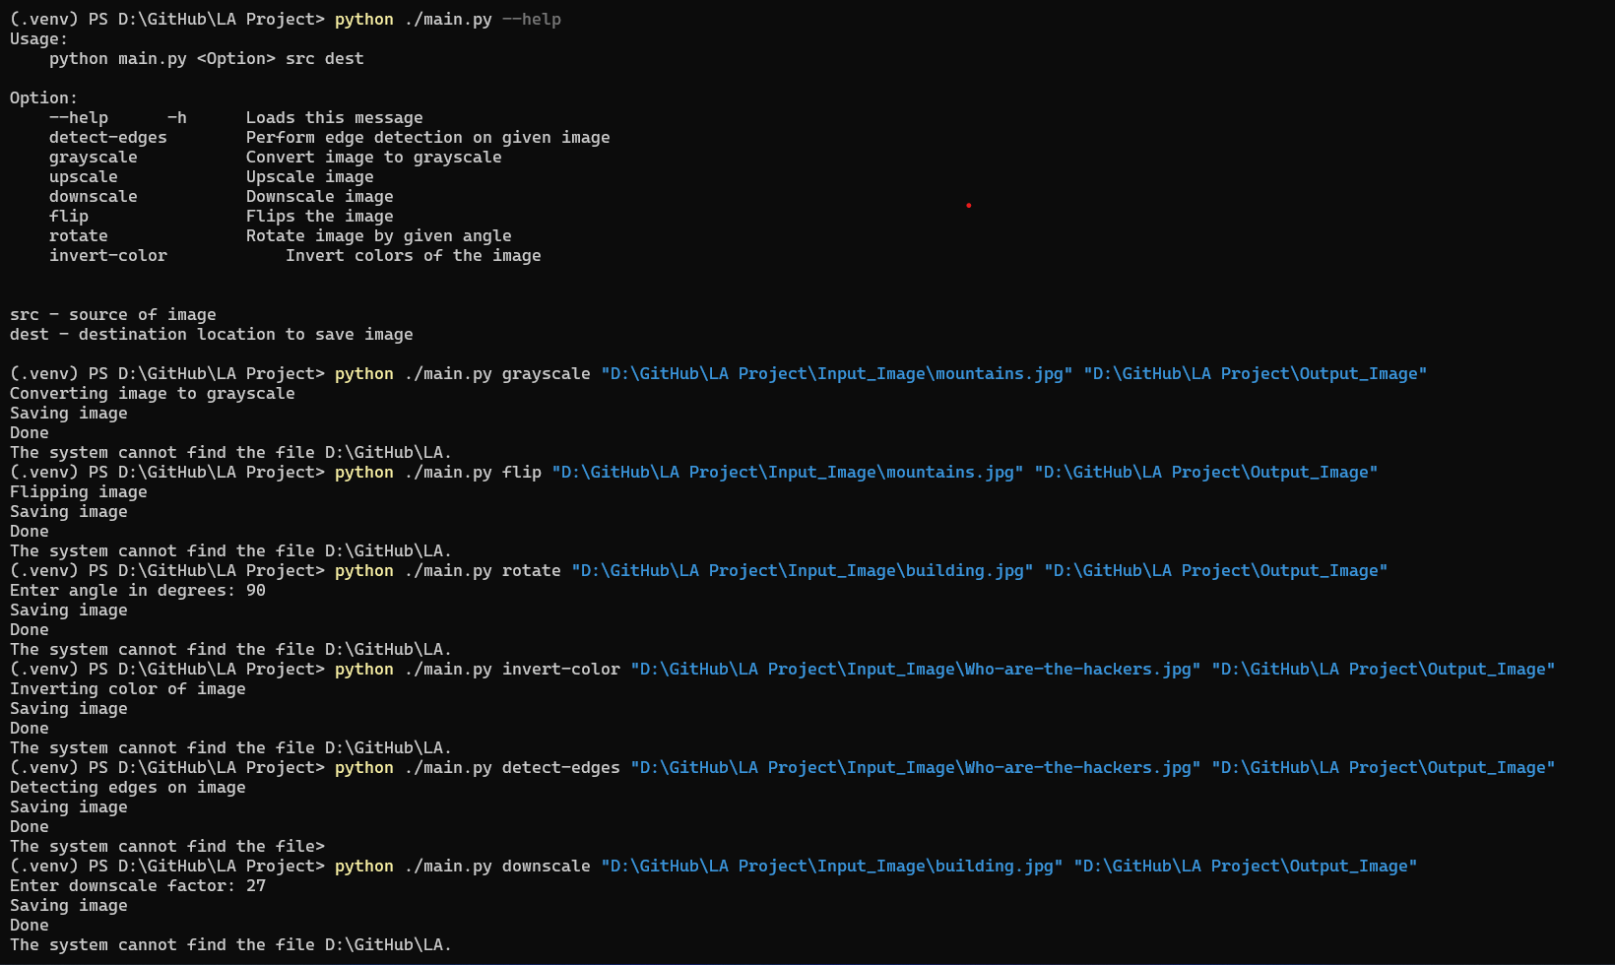
HOW TO RUN

Slide 28
REFERENCES
https://www.projectrhea.org/rhea/index.php/An_Implementation_of_Sobel_Edge_Detection#:~:text=in%20today%27s%20technology.-,The% 20Math%20Behind%20the%20Algorithm,be%20processed%20 separately%20as%20well.
www.researchgate.net%2Ffigure%2FA-three-dimensional-RGB-matrix-Each-layer-of-the-matrix-is-a-two-dimensional-matrix_fig6_267210444&psig=AOvVaw1LIthLfc6s7GwWqpcoaDfm&ust=1650330800817000&source=images&cd=vfe&ved=0CAkQjRxqFwoTCOiM7by3nPcCFQAAAAAdAAAAABAO
https://www.youtube.com/watch?v=PiErX7Y-ho0

Slide 29
REFERENCES
https://www.tutorialspoint.com/dip/grayscale_to_rgb_conversion.htm#:~:text=You%20just%20have%20to%20take,Its%20done%20in%20this%20way.
https://e2eml.school/images_to_numbers.html
https://www.kdnuggets.com/2019/12/convert-rgb-image-grayscale.html

Slide 30
Applications
The modules can be used for creation of Image Editing Tools.
Edge detection is used for controlling drone movement, detection of cracks in machinery, fractures in bones
Greyscale is used in edge-detection and image inversion.

Slide 31
Thank you

